Slide 1
Database Design
S511 Session 3, IU-SLIS

Slide 2
Outline
Database Design: Intro
Database Lifecycle
  Planning & Analysis
  Database Design
  Implementation
  Maintenance
Designer’s View
S511 Session 3, IU-SLIS

Slide 3
Database?: From Data …
Simple dumping of data on the storage medium provides little value.
CUSTOMER
id name address country pay due
100 J. Rodney 12 High Rd., Leeds UK 33.75
523 E. Hoover 52 Ln. Muncie, IN USA 0
800 M. Old Box. 9, Miami, FL USA 12.50
PRODUCT
product_id title cost sale price
123-19-20 Joy of Living 12.50 19.25
169-15-34 Learning Judo 20.00 25.00
354-90-33 Your Dream Home 18.25 24.25
SALE
id zone product_id quantity total price
100 UK 123-19-20 2 38.50
523 USMW 354-90-33 1 24.25
100 UK 169-15-34 1 25.00
800 USSE 123-19-20 1 19.25
S511 Session 3, IU-SLIS

Slide 4
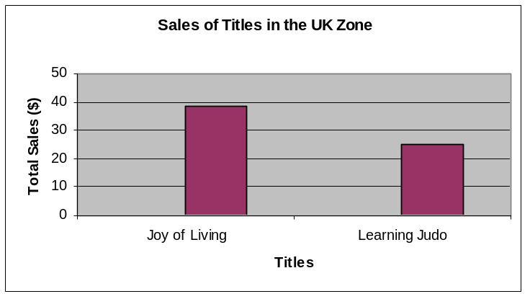
Database: Towards Information
The goal is not just storage of data, but ultimately the extraction of information to support decision making by key people and groups in the organization.
  Data → Information (e.g. reports, tabulations, graphs) → Decisions
-- Summarized fact or information --
In the UK ZONE, Joy of Living had a sale of $38.50, and Learning Judo had a sale of $25.
UK ZONE had the total sale of $63.50, USMW had $24.25, and USSE had $19.25.
SALE by Zone
Title UK USMW USSE total
Joy of Living 38.50 19.25 57.75
Learning Judo 25.00 25.00
Your Dream Home 24.25 24.25
63.50 24.25 19.25 107.00
S511 Session 3, IU-SLIS

Slide 5
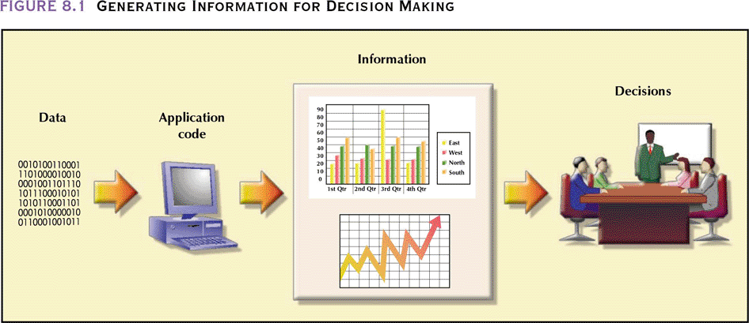
Database: … for Decision Making
(DBMS)
Database Systems: Design, Implementation, & Management: Rob & Coronel
S511 Session 3, IU-SLIS

Slide 6
Database Design: Intro
Database
  Part of an information system
  Carefully designed and constructed repository of facts
Information System
  Provides data collection, storage, and retrieval
  Composed of people, hardware, software, database(s), procedures, and application programs
    applications transform data into information (e.g., report, tabulation, graphic display)
Database Design
  Foundation of a successful information system
  Should promote
    data integrity
    prevent data redundancies & anomalies
  Must yield a database that
    is efficient in its provision of data access.
    serves the needs of the information system.
S511 Session 3, IU-SLIS

Slide 7
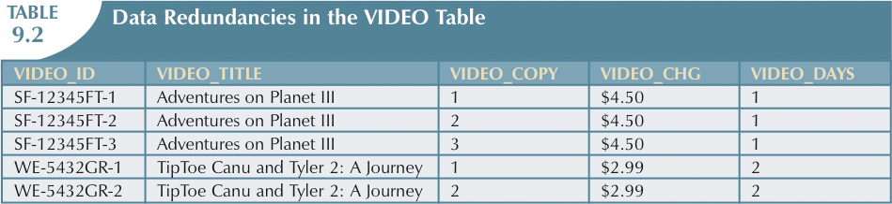
Data Redundancy
S511 Session 3, IU-SLIS

Slide 8
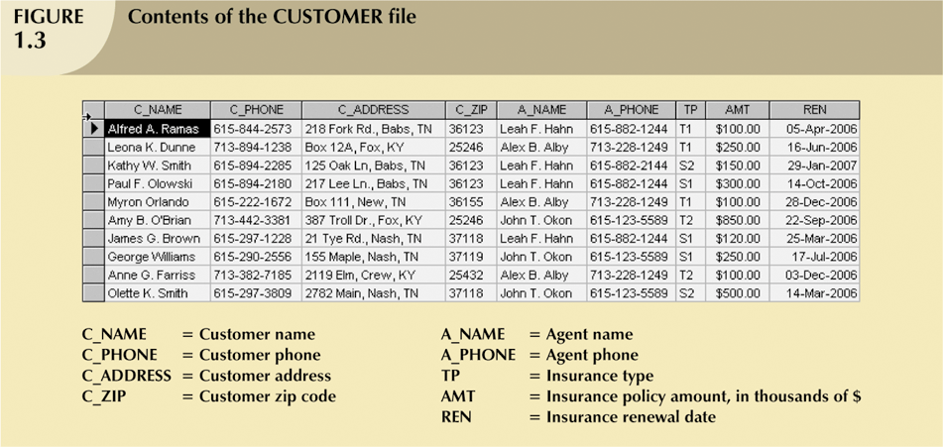
Data Anomaly
Update Anomalies
  - data inconsistencies resulting from “islands of information” problem
Insertion Anomalies
  - creation of bogus record when adding new data (e.g. new agent)
Deletion Anomalies
  - unintended deletion of related data (e.g. agent data when deleting customer)
S511 Session 3, IU-SLIS

Slide 9
Database Development
System Construction
  System Analysis
    establish the need and extent of an information system
  System Development
    design & implement the information system
Database Construction
  Planning & Analysis
  Database Development
    Design
      create complete, normalized, and integrated database models
      establish data management processes
    Implementation
      create storage structure
      load data into database
      provide for data management activities
        data entry/update, report generation, search
    Maintenance
      (corrective & adaptive) modification, upgrade, backup & recovery
S511 Session 3, IU-SLIS

Slide 10
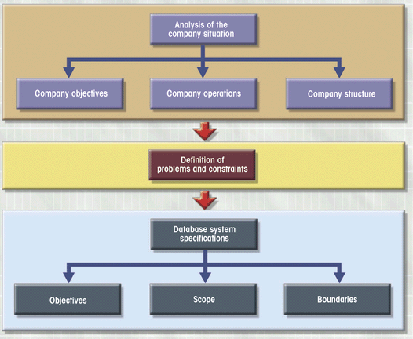
Database Lifecycle: Phase 1
Planning & Analysis
  Discover
    Company Objectives
    Operations & Structure
      what they are
      how they function
      how they interact
    Information Flow
  Identify
    Problems & Constraints
  Define
    Database Specifications
      objectives
      scope
      boundaries
Database Systems: Design, Implementation, & Management: Rob & Coronel
S511 Session 3, IU-SLIS
Notes:
PLANNING
- Yields general overview of company and its objectives
- Initial assessment made of information-flow-and-extent requirements
- Must begin to study and evaluate alternate solutions
-- Technical aspects of hardware and software requirements
-- System cost
ANALYSIS
- Problems defined during planning phase are examined in greater detail during analysis
- Thorough audit of user requirements
- Study existing hardware and software systems
Goal is better understanding of system’s functional areas, actual and potential problems, and opportunities
Includes creation of logical system design
-- appropriate conceptual data model, inputs, processes, and expected output requirements

Slide 11
Database Lifecycle: Planning & Analysis
Analyze Company Situation
  What is organization’s general operating environment & its mission?
    what are operational components, how do they function & interact?
    design must satisfy the operational demands created by the organization’s mission
  What is organization’s structure?
    who controls what and who reports to whom?
    design involves defining information flows, queries, reports, etc.
Define Problems & Constraints
  What are the problems to be solved?
  What are the constraints that limit the database design?
    e.g. time, budget, personnel, etc.
Define Objectives
  Database should be designed to help solve the major problems.
    examine the problem space for possible database solutions.
Define Scope and Boundaries
  Consider factors that force the design into a specific mold
  Scope defines the extent of design.
    data structures, type & number of entities, size of database
  Boundaries
    imposed by (resource) constraint, existing hardware/software
S511 Session 3, IU-SLIS
Notes:
Analysis
–To break up any whole into its parts so as to find out their nature, function, and so on
Company situation
- General conditions in which company operates, its organizational structure, and its mission
Analyze company situation
- Discover what company’s operational components are, how they function, and how they interact
Define problems & constraints
- Managerial view of company’s operation is often different from that of end users
- Designer must continue to carefully probe to generate additional information that will help define problems within larger framework of company operations
- Finding precise answers is important
Defining problems does not always lead to perfect solution
Define objectives
- Designer must ensure that database system objectives correspond to those envisioned by end user(s)
Designer must begin to address following questions:
-- What is proposed system’s initial objective?
-- Will system interface with other existing or future systems in the company?
-- Will system share data with other systems or users?

Slide 12
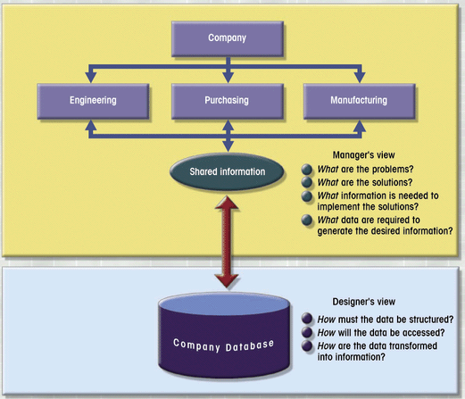
Database Lifecycle: Phase 2
Database Design
  Create Database Model
    To support company operations and objectives
    To meet system requirements
    To meet user requirements
  Focus on Data Requirements
    Data structure
    Data access
    Data to info. transformation
  Subphases
    Conceptual Design
    DBMS software selection
    Logical Design
    Physical Design
Two Views of Data
Database Systems: Design, Implementation, & Management: Rob & Coronel
S511 Session 3, IU-SLIS
Notes:
Necessary to concentrate on data
Characteristics required to build database model
Two views of data within system:
Business view of data as information source
Designer’s view of data structure, its access, and activities required to transform data into information

Slide 13
DB Design: Conceptual Design
Create a conceptual model
  i.e., Abstract data structure that represent real-world items.
  Need to understand how business works and what role data plays
  Software and hardware independent
Minimal Data Rule:
  “All that is needed is there, and all that is there is needed.”
  Make sure that all data needed are in the model, and that all data in the model are needed.
Conceptual Design Steps
  Data Analysis & Requirements
  E-R Modeling & Normalization
  Data Model Verification
S511 Session 3, IU-SLIS
Notes:
E-R model verification
E-R model is verified against proposed system processes.
End-user views and required transactions
Access paths, security, concurrency control
Business-imposed data requirements and constraints

Slide 14
Conceptual Design: Data Analysis & Requirements
Discover the data that can be transformed into desired information
  Information Need
    What kind of information is needed?
      what output (queries & reports) must be generated by the system?
  User Characteristics
    Who will use the information?
    How will information be used?
  Information Source
    Where is the information to be found?
    How is the information to be extracted?
  Information Constitution
    What data elements are needed to produce the information?
    What are the data attributes and relationships?
    What data transformations are to be used to produce the information?
Develop a thorough understanding of the company’s data
  Flow, uses, characteristics
    Data Flow Diagram
Data sources
  Interviews, direct observation
  Business Rules
    Narrative description of policy & procedures
S511 Session 3, IU-SLIS

Slide 15
Conceptual Design: E-R Modeling
E-R Modeling steps
  Identify, analyze, and refine the business rule
  Identify the main entities
  Define the relationships among entities
  Define attributes, primary keys, and foreign keys for each entity
  Create an initial E-R diagram
  Normalize the entities
    process for evaluating & designing good table structures
      reduce data redundancies & help eliminate data anomalies
  Verify the model & modify the E-R diagram iteratively
  Data Dictionary
    Defines all objects (entities, attributes, relations, etc.)
    Used in tandem with the normalization process
      to help eliminate data anomalies & redundancy problems
S511 Session 3, IU-SLIS

Slide 16
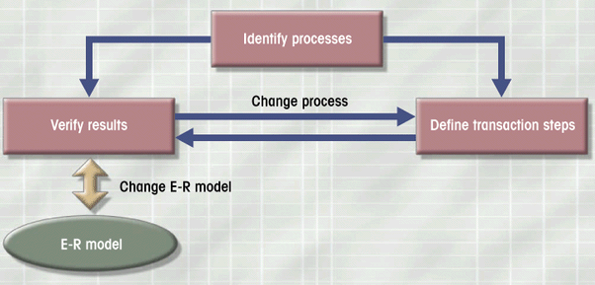
Conceptual Design: E-R Model Verification
E-R model is verified against proposed system processes.
  Corroboration that intended processes can be supported by the database model
  Careful reevaluation of the entities and detailed examination of attributes
  Verification of business transactions as well as system and user requirements
May reveal additional entity and attribute details.
Verification process is iterative.
  identify ER model’s central entity
  identify modules/subsystems & components
  identify transaction requirements
    update/insert/delete/query/report
    user interface
  verify all processes against ER model
  make necessary changes
  repeat steps 2 through 5
Database Systems: Design, Implementation, & Management: Rob & Coronel
S511 Session 3, IU-SLIS
Notes:
E-R model is verified against proposed system processes.
End-user views and required transactions
Access paths, security, concurrency control
Business-imposed data requirements and constraints

Slide 17
DB Design: DBMS Selection
What are the advantages & disadvantages?
  Cost
    purchase, maintenance, operational, training, etc.
  Features & Tools
    ease-of-use, performance, DB administration, etc.
    application development tools
  DB model
    hierarchical, RDB, Object-oriented, etc.
  Portability
    platform, O/S, SQL
  Hardware requirement
    processor, RAM
S511 Session 3, IU-SLIS

Slide 18
DB Design: Logical & Physical Design
Logical Design
  Translate conceptual design into internal model that maps objects in model to specific DBMS constructs
    From software independent to software dependent
  Detailed & functional descriptions of system components
    Specify system processes and I/O.
    e.g., table design, attribute definitions, access restrictions
Physical Design
  Select the data storage and data access characteristics of the database
    More important in older hierarchical and network models
    Becomes more complex when data are distributed at different locations
  Can affect the database performance
    e.g. storage media, buffer size, etc.
  Designers favor software that hides physical details
S511 Session 3, IU-SLIS

Slide 19
Database Lifecycle: Phase 3 & 4
Implementation
  Create the database
    Tables, forms, queries, reports
    Programming: SQL, VBA
    Security provisions: password, access rights, data encryption
  Fine-tune
    Repeated testing, debugging and evaluation
Maintenance
  Preventative maintenance
    To prevent and prepare for problem situations (e.g. backup)
  Corrective maintenance
    To address database system error (e.g. recovery)
  Adaptive maintenance
    To adapt to the external changes (e.g. database update, enhancement)
  General maintenance
    Security audits, system-usage analysis
S511 Session 3, IU-SLIS

Slide 20
Database Design Strategies
Top-down vs. Bottom-up
  Top-down design (e.g., E-R modeling)
    Identify entities/data sets.
    Define attributes/data elements for each entity.
  Bottom-up design (e.g., normalization)
    Identify attributes.
    Group them together to define entities.
Centralized vs. Decentralized
  Centralized design
    small number of objects and procedures
    single design process
  Decentralized design
    large number of entities with complex relations and operations
    multiple parallel design of subsystems & aggregation
S511 Session 3, IU-SLIS

Slide 21
DB Lifecycle: Designer’s Perspective
Planning
Maintenance
Analysis
Design is a never-ending process...
conceptual design
Implementation
S511 Session 3, IU-SLIS

Slide 22
DB Design: Step 1. Planning
Business Plan or Org. Goals
Database
Development Projects
Information Needs
Database Plan
Strategic Planning
  Objectives:
    Understand the business model
      Organizational goal
      Product and information flow
    Assess the information need
    Put together an initial database plan
  Activities:
    Take stock of what is in place
    Interacts with users at all levels
      end-user, managers, support staff
S511 Session 3, IU-SLIS

Slide 23
Product & Info Flow in Organization
DB designer must establish the product & info flow in the organization.
Business Office:
Book Purchasing
Inventory Management
Store
Warehouse
Publishers
Customers
Barney & Nimble Inc.
S511 Session 3, IU-SLIS

Slide 24
Product & Info Flow in Organization
Product & Information flow varies from organization to organization.
  Warehouse and inventory can use information about orders going out to publishers.
  Online department needs to have information on inventory.
  Online department can also use information about pending orders.
Book Purchasing
&
Collection Management
Warehouse Maintenance
&
Inventory
Online Presence
&
Sales
Publishers
&
Distribution Centers
Fulfillment
Customers
Amazing.com
S511 Session 3, IU-SLIS

Slide 25
Centralized Information Flow
Periodic
Management
Report
Amazing
Sales & Acquisition
Group
invoice &
other data
queries
electronic
payments
record
screens
Publishers
Consumers
shipping
info
inventory
update
Warehouse
S511 Session 3, IU-SLIS

Slide 26
DB Design: Step 2. Analysis
Requirement Analysis
  Examination of existing database environment
    What hardware and software are available?
    What files/records are in use?
    What is under development?
  From Information Need to Database Requirement
    What type of information is desired?
    What can database system do to satisfy the information need?
    Why design it? What would it improve?
  Feasibility Analysis
    Technological
    Operational
    Economical
S511 Session 3, IU-SLIS

Slide 27
DB Design: Feasibility Analysis
Technological Feasibility
  What hardware, software, and additional resources would be needed?
  What is available in-house? What has to be purchased?
  How will the new system be integrated?
Operational Feasibility
  Who will design the system?
  Who will maintain the system?
  Who will do training or help-desk support?
  Can the available personnel provide the time? New personnel necessary?
Economic Feasibility
  Expected cost of the overall project ($)?
    Software, hardware, application development, staff-time
    Hidden cost (unforeseen)
  Other costs
    What is the competition/comparable unit doing?
    Would data sharing among departments lead to additional expenses?
  Benefits
    How soon expected?
S511 Session 3, IU-SLIS

Slide 28
DB Design: Step 3. Design
Conceptual Design
  Map organizational & user needs to a conceptual model
  Data Modeling
    Relational tables, attributes, & constraints
  Event Table
    list of events that will occur within the database system
  Use Cases
    description of how users will interact with the system
  User interfaces
Conceptual
Data Model
Relational
Data Model
Relational
DBMS
E-R modeling
Schema & Normalization
S511 Session 3, IU-SLIS

Slide 29
Data Modeling
What is Data Modeling?
  A model is a representation of reality that retains only carefully selected essential details.
  Logical organization of data for optimum information extraction and data manipulation
Why Model?
  To understand and identify essential data elements
  To produce a representation that can be transformed into a schema
How?
  Data modeling involves
    identifying entities, attributes, and relationships
S511 Session 3, IU-SLIS

Slide 30
Data Modeling: Bank Example
N
ID#
Checking
Account
Balance
M
Has Chkg-Acct
Customer
M
Has Sav-Acct
Savings Account
Balance
N
Person
Institution
Birthday
Gender
Org. Type
# Employee
S511 Session 3, IU-SLIS

Slide 31
Lab: Group Project (ongoing)
Form a Project Group.
Identify a potential project.
Discuss the database plan and consider its merit and feasibility.
  What is the purpose of the database?
  Why is it needed? What should it do?
  Who are the users and what are their information needs?
  What are the questions that the system should answer?
  What input data is available to the database?
  What kind of information should be stored in the database?
Study the client organization and the end-users
  Information Flow
  User Requirements (e.g. database tasks, queries, interface)
Define a database plan
  Enumerate the tasks it will perform and questions it will answer
Construct the conceptual model of the database
  Write out the business rules
  Identify the entities, attributes, relationships
S511 Session 3, IU-SLIS

